Slide 1


Fundamentals of Machine Learning
PREDICTING SALES OF MARKETPLACE USING XG BOOST ALGORITHM BASED ON PRODUCT SALES
Team Members:
1. VIMAL KB (210701309)
2. SRI SAI B(210701258)
PROJECT CO-ORDINATOR:
V Karthick
Associate Professor
Department of CSE
Rajalakshmi Engineering college

Slide 2
AGENDA
ABSTRACT
INTRODUCTION
LITERATURE SURVEY
EXISTING SYSTEM
PROPOSED SYSTEM
PROPOSED METHODOLOGY
RESULTS AND DISCUSSION
OUTPUT
CONCLUSION AND FUTURE ENHANCEMENTS
REFERENCES

Slide 3
ABSTRACT
In today’s business environment, it is difficult to predict the future sales of a product. It is a big task in the business world. In our proposed system it discusses the prediction model that will be able to predict sales of a particular product in the market with the help of numerous dataset. This research was for drawing better-required accuracy from the model compared to the previous models. In this project, we propose a model using the Xgboost algorithm for predicting sales of companies and found that it produces better performance and accuracy compared to existing model.
Keywords: Marketplace, sales, Linear Regression, Random forest Algorithm, XGboost Algorithm, Outlet price.

Slide 4
INTRODUCTION
In today’s business environment, it is difficult to predict the future sales of a product. It is a big task in the business world. Machine learning is the trending technology in the world right now, it works with numerous data sets. Retailers can predict sales with the help of these datasets available. The dataset contains the previous sales information over some time. This research focuses on leveraging machine learning techniques to predict sales trends and optimize their strategies accordingly. Marketplace offers all kinds of products to customers in a wide range. It is a big task to efficiently maintain and manage their inventory and get the right product to their inventory which customers like to buy more.

Slide 5
LITERATURE SURVEY
SI.NO | NAME OF THE PAPER | AUTHOR | YEAR
1. | Walmart's Sales Data Analysis Big Data Analytics Perspective. | M. Singh, B. Ghutla, R. Lilo Jnr, A. F. S. Mohammed, and M. A. Rashid | 2022
2. | Location-Based Crime Prediction Using Multiclass Classification Data Mining Techniques | V Upadhyay, D Rathod | 2022
3. | Business Transformation Using Big Data Analytics and Machine Learning . | P Majumdar, S Mitra | 2022
4. | Prediction of quality food sale in mart using the AI-based TOR method | D Irfan, X Tang, V Narayanan, PK Mall | 2022
5. | Machine learning application for black Friday sales prediction framework | HV Ramachandra, H Patil | 2021

Slide 6
LITERATURE SURVEY
SI.NO | NAME OF THE PAPER | AUTHOR | YEAR
6. | Future sales prediction for Indian products using convolutional neural network-long short term memory. | P Kaunchi, T Jadhav, Y Dandawate | 2021
7. | Using machine learning to predict retail business volume | MA Scarpati, A Krowitz, M Tapp | 2021
8. | Forecasting new product demand using machine learning | PS Smirnov, VA Sudakov | 2021
9. | Sales prediction model for Big Mart | N Malik, K Singh | 2020
10. | Comparative analysis of supervised machine learning techniques for sales forecasting | S Raizada, JR Saini | 2019

Slide 7
EXISTING SYSTEM
Mostly several regression models were used to predict the sales of the market. In the paper titled “Sales prediction Model for Big Mart” by N Malik, and K Singh in 2020 the proposed solution of this paper uses ‘Big Mart’ as the dataset. The Algorithms used in this system were LR, DT, and RF algorithms. Here python is used as a programming language and Jupyter Notebook is used as a tool. This Proposed Solution is mainly used to predict the future sales of the company with a maximum accuracy of 60.8% using the Random Forest Algorithm. In this paper several algorithms were used to predict the accuracy of the system, In that RF algorithm produces maximum accuracy.

Slide 8
PROPOSED SYSTEM
Our proposed model predicts the Market sales of the company and also uses XGboost algorithm to enhance the accuracy of the system. The trained model is used to predict the sales of the company and also helps in early prediction of the future sales of that company for that we uses LR, RF, and XGB algorithms to predict the accuracy and sales of the system. In this System, XGB was found to be more suitable with an accuracy rather than the RF algorithm. . By using this prediction of Market sales we can improve the satisfaction of the customers and optimize the stock levels for profitability.

Slide 9
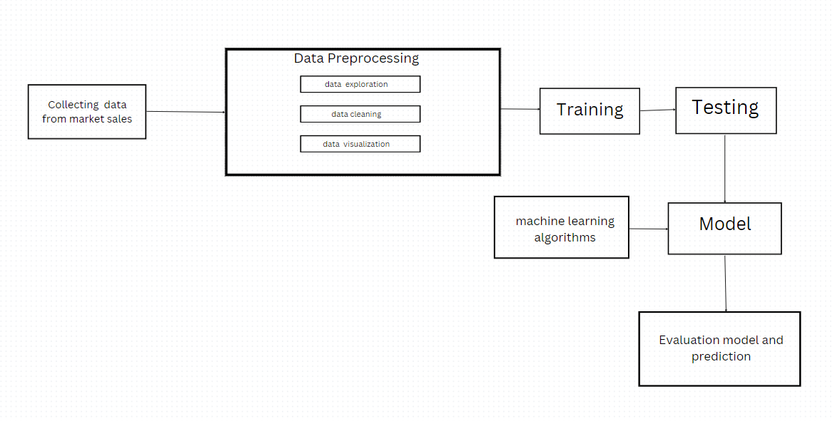
PROPOSED METHODOLOGY

Slide 10
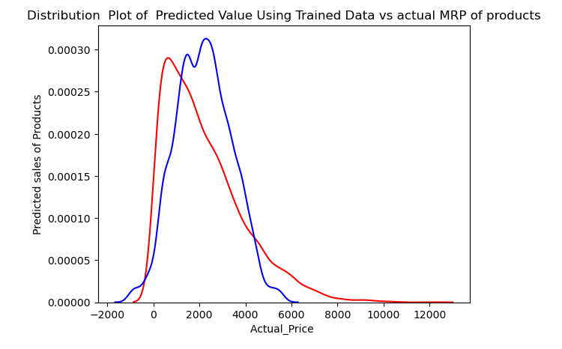
RESULTS AND DISCUSSIONS
TRAINING AND TESTING ACCURACY GRAPH:
Thus our model is tested against the test data and the testing and training accuracy graph has been plotted, where the blue line indicates the Testing dataset accuracy graph and the Red line indicates Trained set accuracy graph.

Slide 11
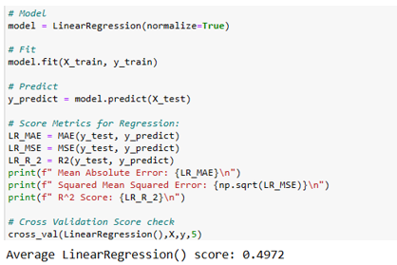
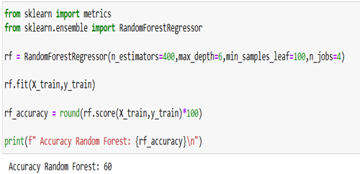
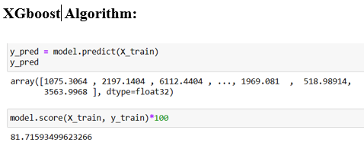
RESULTS AND DISCUSSION
For performance analysis, we can go and look for the accuracy value of the different algorithms performed and check for which algorithm gives us the best performance with higher accuracy.
Linear Regression: Random Forest Algorithm:

Slide 12
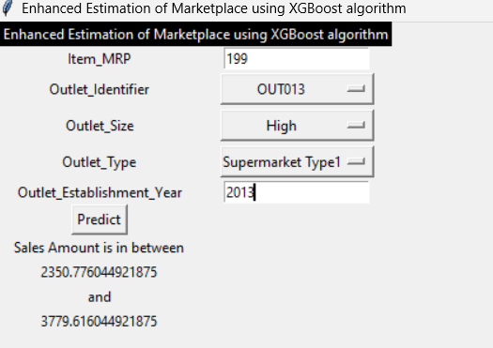
OUTPUT
PREDICTING MARKET SALES OF PRODUCT:
Thus we conclude that the sales of the Product from the particular store have been predicted by using the Machine learning Model.

Slide 13
COMPARATIVE ANALYSIS
By using techniques such as Linear regression, Random Forest, and XGBoost algorithm, we can analyze the location of the Market, store type and predict future sales. From the proposed approach it was found that for the model evaluation XGBoost algorithm is more accurate than other models and gives the predicted outcomes.
ALGORITHM USED | EXISTING MODEL | PROPOSED MODEL
Linear Regression | 49.2 | 49.72
Random Forest Algorithm | 60.8 | 60
Xgboost algorithm | - | 81.71

Slide 14
CONCLUSION
Thus the proposed approach accurately detects and predicts the future sales of the market. By using techniques such as LR, RF, and XGB, we can analyze the location of the Market, and store type and predict future sales. From the proposed approach it was found that for the model evaluation XGB algorithm is more accurate than other models and gives the predicted outcomes. This project achieves an accuracy rate of 81% when compared with the existing model it produces the accuracy rate of 60% using Random forest algorithm but in our proposed model we use XGboost algorithm to increase the performance of the model by enhancing its accuracy so that there will be an enhanced estimation of the sales of a company. By using this prediction of Market sales we can improve the satisfaction of the customers and optimize the stock levels for profitability.

Slide 15
FUTURE ENHANCEMENT
Advanced Algorithms:
Neural Networks: Experiment with deep learning models, such as LSTM (Long Short-Term Memory) networks, which are well-suited for forecasting.
Automated Machine Learning (AutoML): Use AutoML tools to automate the model selection and hyperparameter tuning process.
Evaluation Metrics: Use additional evaluation metrics such as MAE (Mean Absolute Error), MAPE (Mean Absolute Percentage Error), and R² score for a comprehensive assessment of the model performance in model evaluation and validation.

Slide 16
REFERENCES
[1] M. Singh, B. Ghutla, R. Lilo Jnr, A. F. S. Mohammed, and M. A. Rashid, "Walmart's Sales Data Analysis Big Data Analytics Perspective," 2022 4th (APWC on CSE), Mana Island, Fiji, 2022.
[2] V Upadhyay, D Rathod,” Location-Based Crime Prediction Using Multiclass Classification Data Mining Techniques”,2022.
[3] Business Transformation Using Big Data Analytics and Machine Learning P Majumdar, S Mitra -,2022.
[4] D Irfan, X Tang, V Narayanan, PK Mall . ‘Prediction of quality food sale in mart using the AI-based TOR method”, 2022.
[5] HV Ramachandra, H Patil,” Machine learning application for black Friday sales prediction framework”, 2021.

Slide 17
REFERENCES
[6] P Kaunchi, T Jadhav, Y Dandawate. “Future sales prediction for Indian products using convolutional neural network-long short term memory”, 2021.
[7] MA Scarpati, A Krowitz, M Tapp,” Using machine learning to predict retail business volume”, US Patent 11,068,916, 2021.
[8] PS Smirnov, VA Sudakov.”Forecasting new product demand using machine learning” Journal of Physics: Conference, 2021.
[9] N Malik, K Singh.” Sales prediction model for Big Mart”, 2020.
[10] S Raizada, JR Saini “Comparative analysis of supervised machine learning techniques for sales forecasting “, Journal of Advanced Computer Science, 2019.

Slide 18
REFERENCES
[11] G Behera, N Nain. ”GSO based future sales prediction for big mart”, Conference on Signal-Image Technology, 2019.
[12] K Punam, R pamula, PK Jain. ”A two-level statistical model for big mart sales prediction”, 2018.

Slide 19
THANK YOU

